Slide 1
Battery-Free Eye Tracker on Glasses

Slide 2
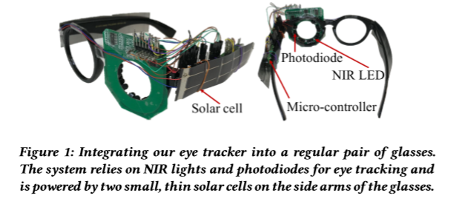
high tracking rates (above 100 Hz) with sub-millimeter accuracy
consuming power at microwatt levels.

Slide 3
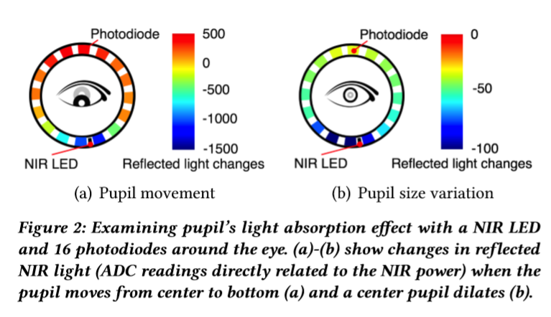
Each photodiode has a limited field-of-view and thus perceives the light reflected only by a small region of the eye. As the pupil moves, it weakens the light reflected in its direction; as the pupil narrows or widens during constriction or dilation, it absorbs less or more light, resulting into a global rise or fall of reflected light. Thus, pupil movement and pupillary response result in changes in reflected light, providing the basis for tracking pupil’s position and size.

Slide 4
challenge
a sub-millimeter pupil movement or size variation can result in negligible differences in reflected light intensities sensed by the photodiodes, which severely limits the system’s sensing resolution and accuracy.
even though photodiodes consume low power, realizing high tracking rates with microwatt-level power consumption is still challenging.

Slide 5
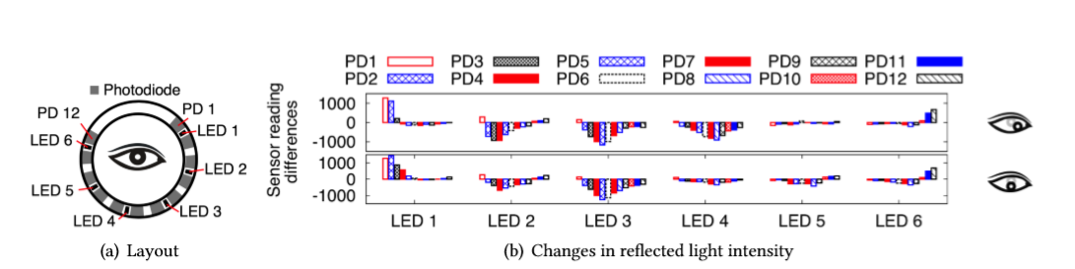
Sensing with Multiple NIR Lights：
M NIR lights with N photodiodes, providing M × N data points with (M + N ) hardware components at each time instance.

Slide 6
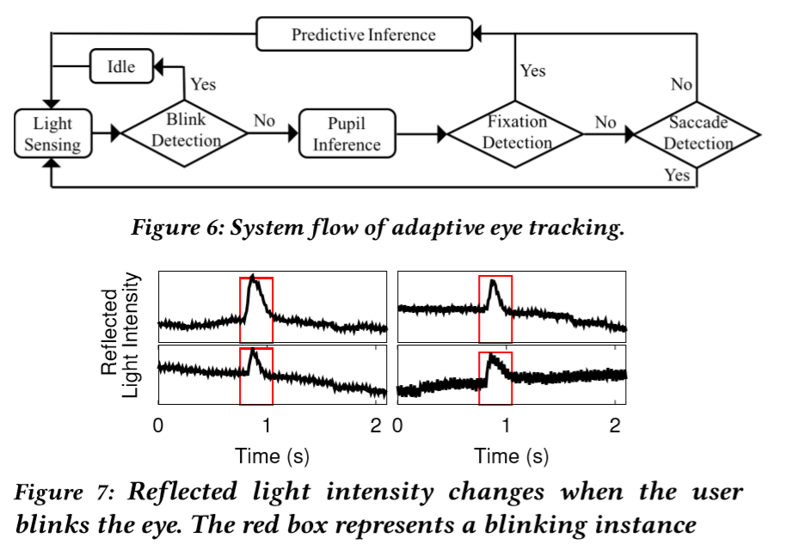

Slide 7
这周做了哪些事情？

Slide 8
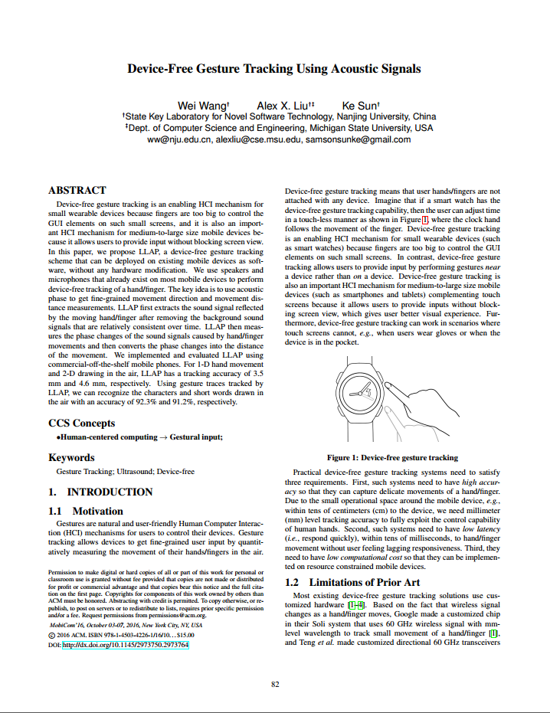
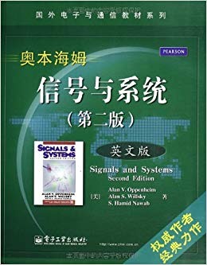
Learning
信号与系统
实验课和OOAD冲突，只旁听了理论课
读完第一章，完成练习
Reading
Device-Free Gesture Tracking Using Acoustic Signals
概要
Gesture Tracking 相关技术
LLAP方法

Slide 9
Device-Free Gesture Tracking Using Acoustic Signals
文章的主要工作
使用Low-Latency Acoustic Phase方法，利用Mobile device 里的已有设备实现手势识别
使用COTS设备实现毫米级精度和15ms以下延迟的手势识别(适用1-D,2-D情况)
低于3%的CPU使用
亮点：不需要额外的设备支持，在手机或其他有收发声音的设备中安装软件即可实现

Slide 10
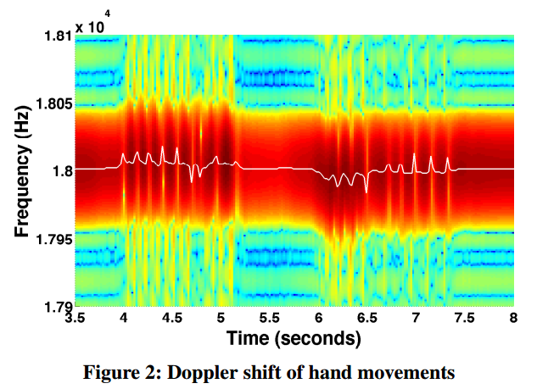
Measure 1-D Relative Distance
Doppler Shift measurement not suit for Device-free gesture tracking
STFT has low resolution
Highly noisy result
Phase Based Distance Measurement
Accuracy is much higher
Latency is much lower（shorter data segment)
Speed resolution is much higher

Slide 11
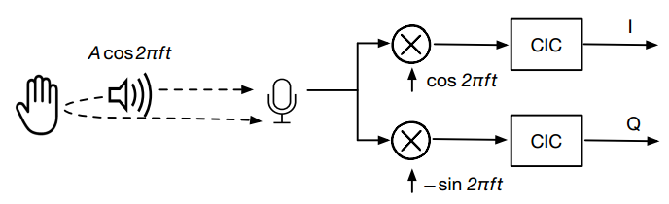

Measure 1-D Relative Distance
Low-Latency Acoustic Phase
Use continuous wave
$$Acos2πft$$

Slide 12
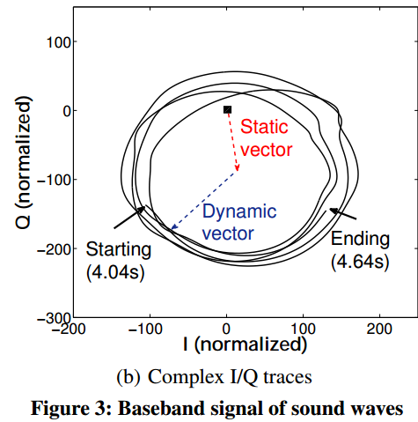
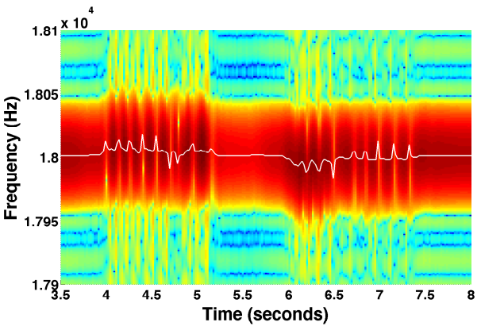
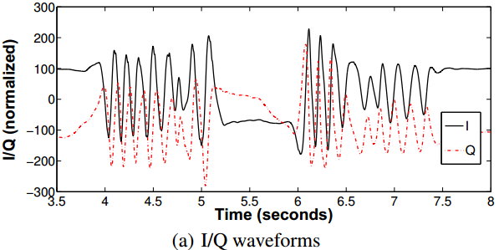
读文章遇到的问题
遇到陌生的术语或者方法就会卡住
应该把细节查清楚还是先通篇阅读

Slide 13
下周要做的事情
读完Device-Free Gesture Tracking Using Acoustic Signals

Slide 14
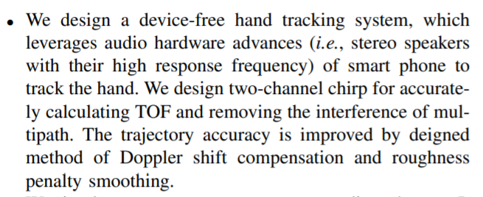
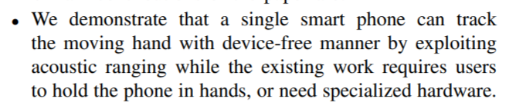
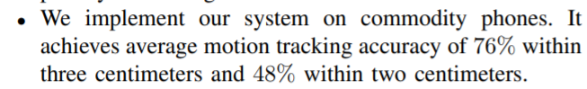
EchoTrack: Acoustic Device-free Hand Tracking on Smart Phones

Slide 15
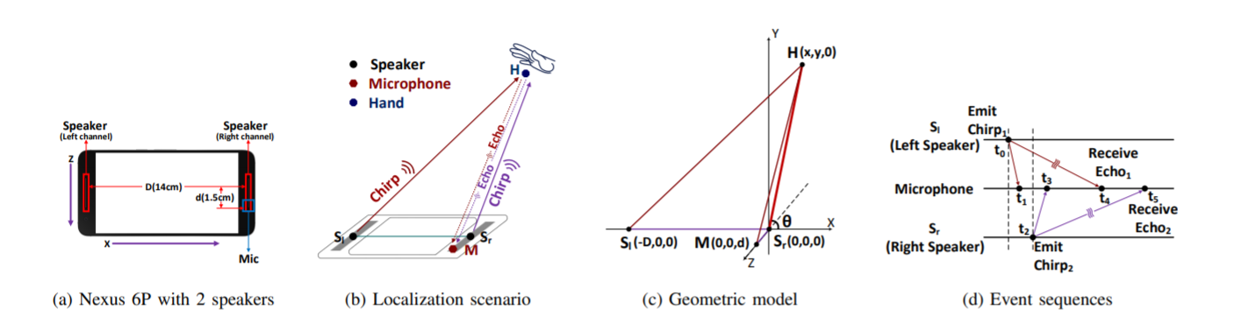
Basic Model

Slide 16
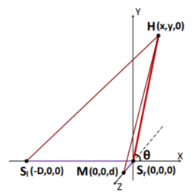
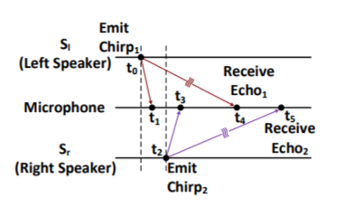
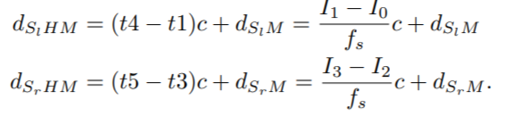
Distance Extract

Slide 17
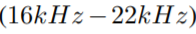
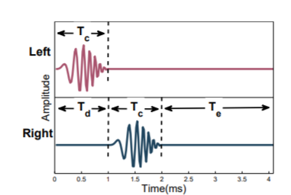
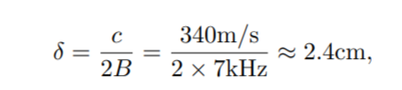
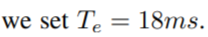
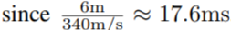
Signal Generation

Slide 18
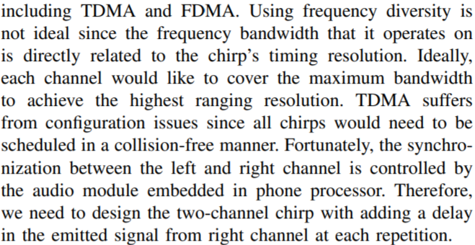
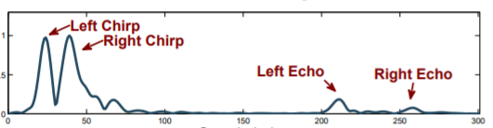
Signal Generation

Slide 19
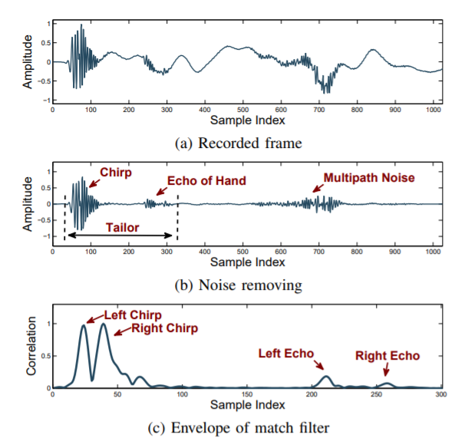
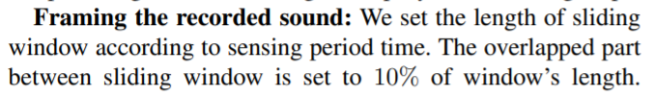
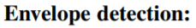
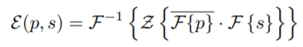
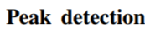
Signal Receive

Slide 20
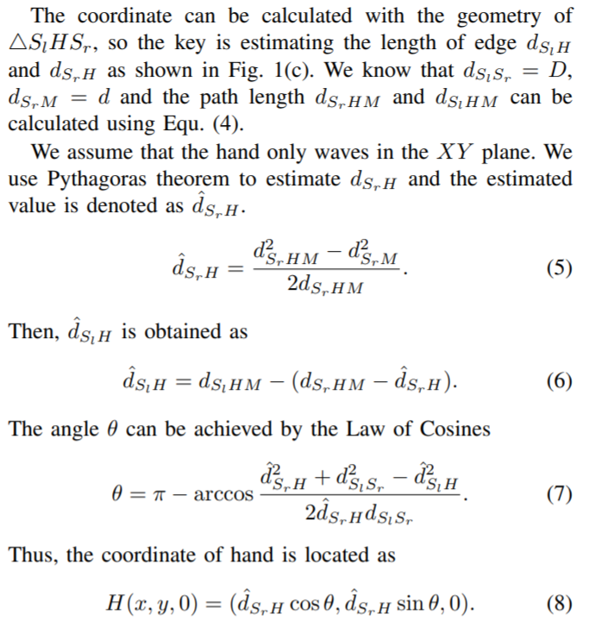
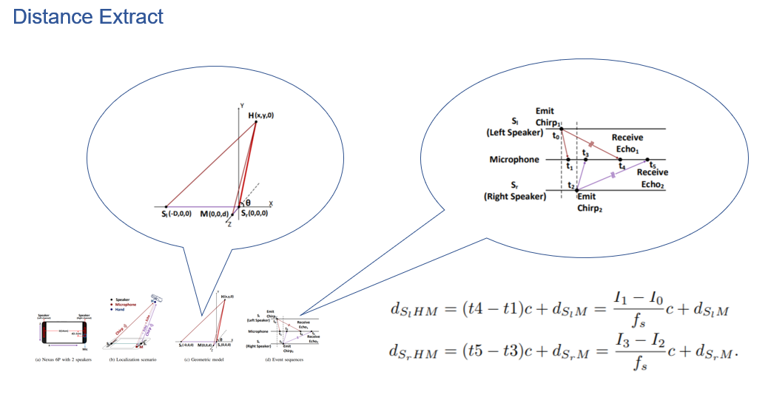
Coordinates Calculation

Slide 21
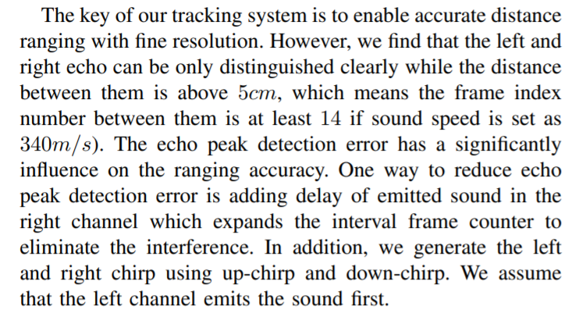
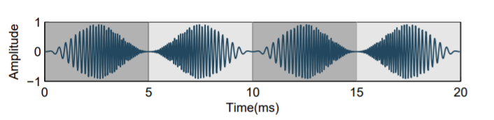
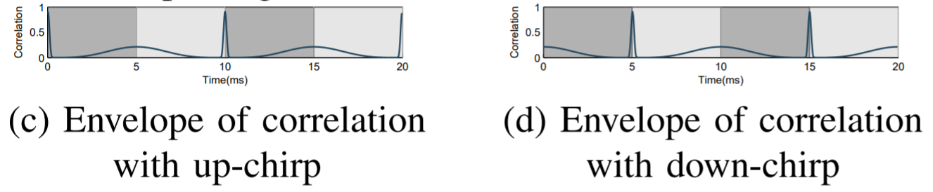
Ranging Accuracy Improvement

Slide 22
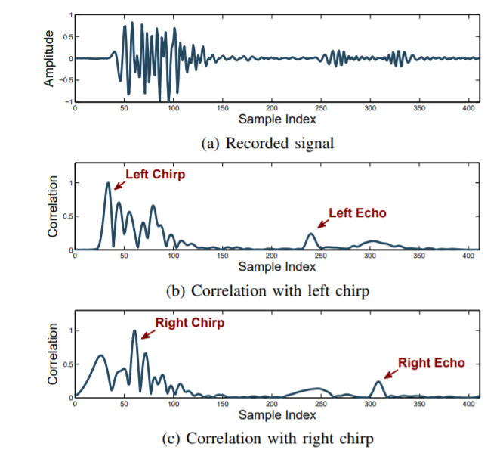
Ranging Accuracy Improvement

Slide 23
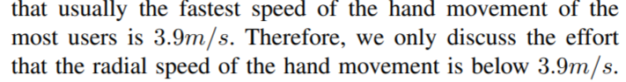
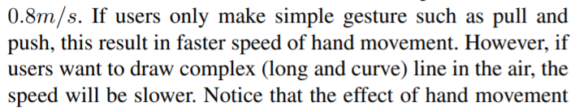
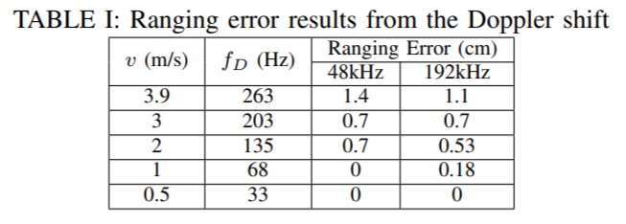
Trajectory Estimation

Slide 24
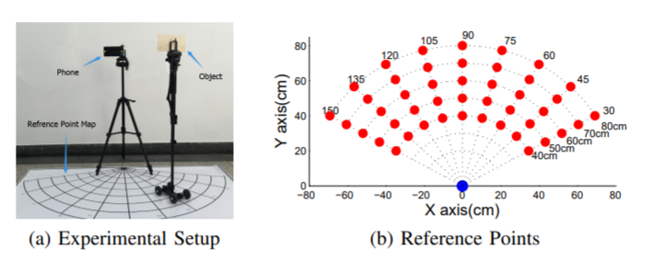
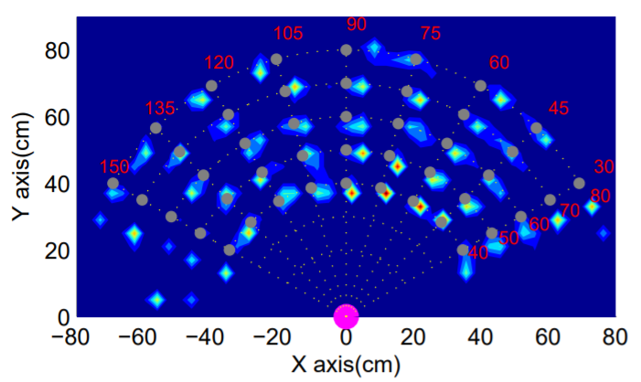
Results

Slide 25
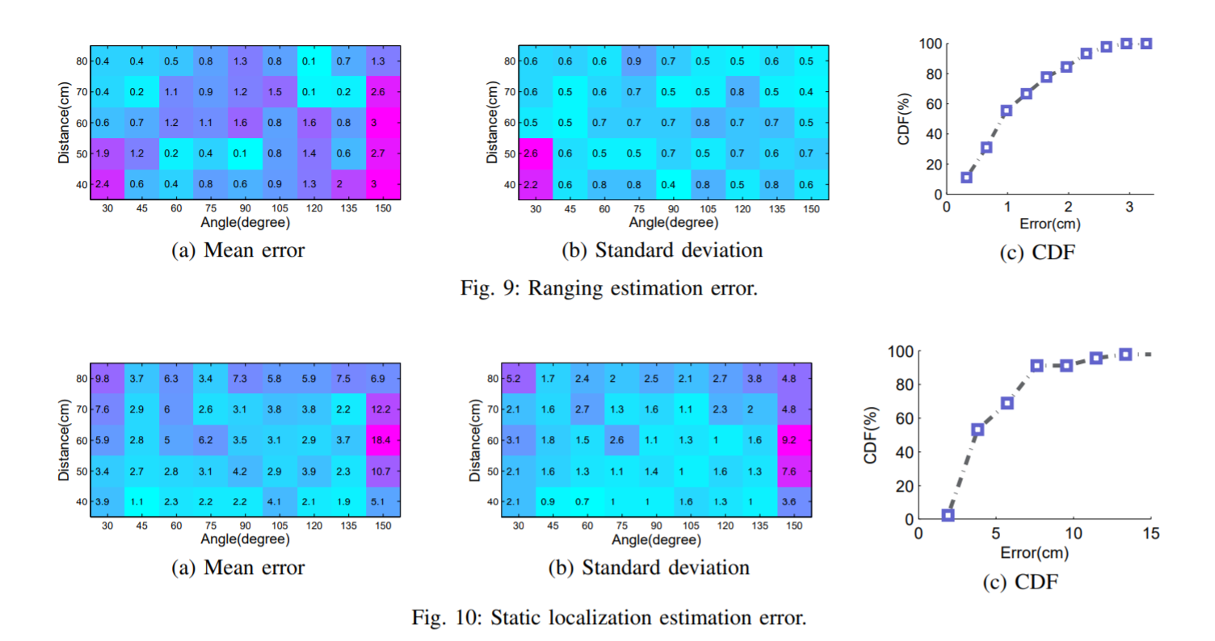
Results

Slide 26
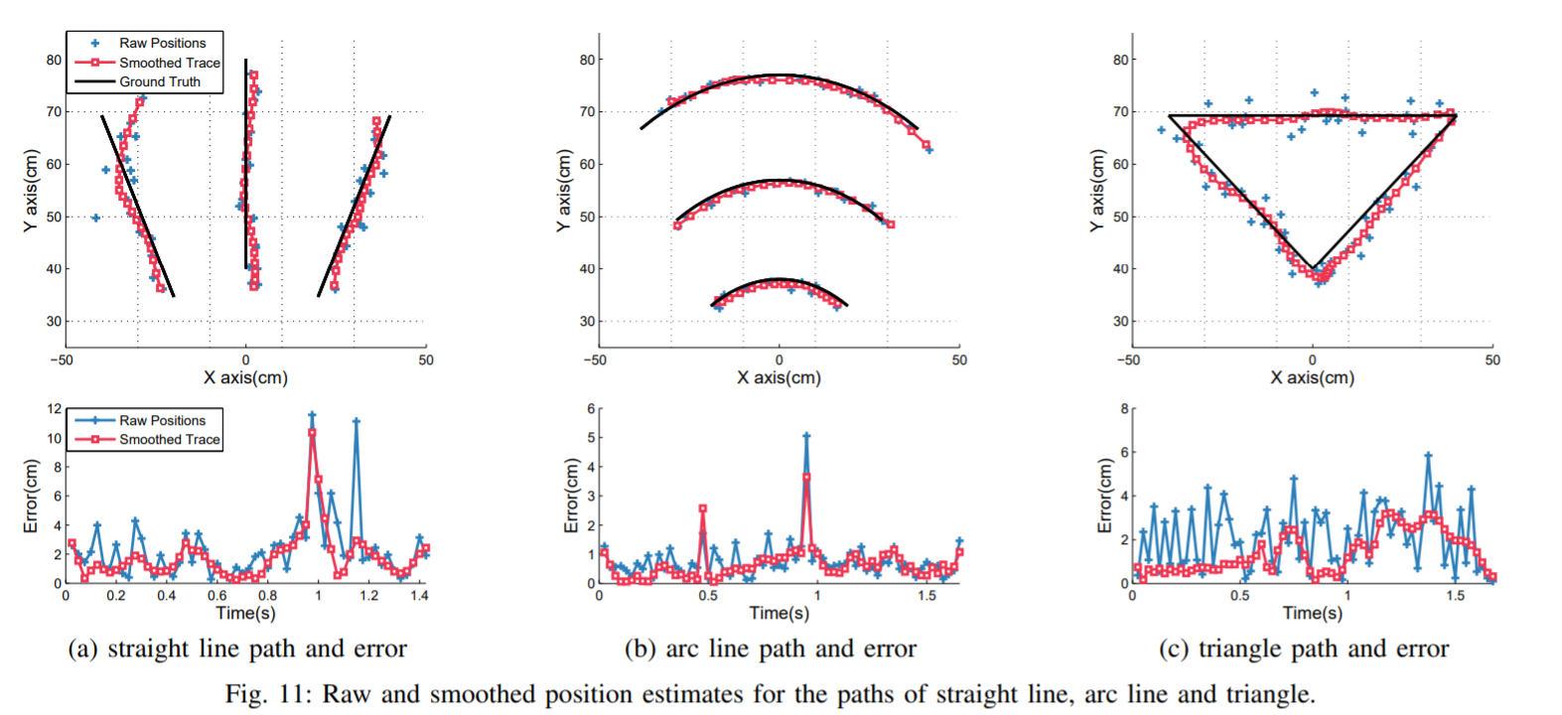
Results

